Slide 1


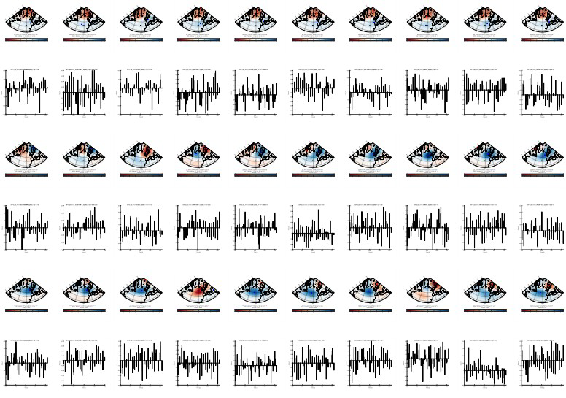
Selecting CMIP6 models for dynamical downscaling: The case of the NAO
Florian Sauerland, Susann Aschenneller (University of Bonn)
Ruth Mottram (Danish Meteorological Institute)
Notes:
1

Slide 2


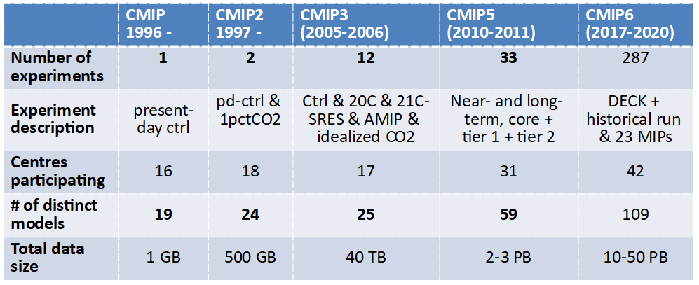
The challenge of CMIP6
courtesy Shuting Yang
Polar Cordex Meeting at DMI Copenhagen 07.10. - 09.10.2019
Slide 1

Slide 3
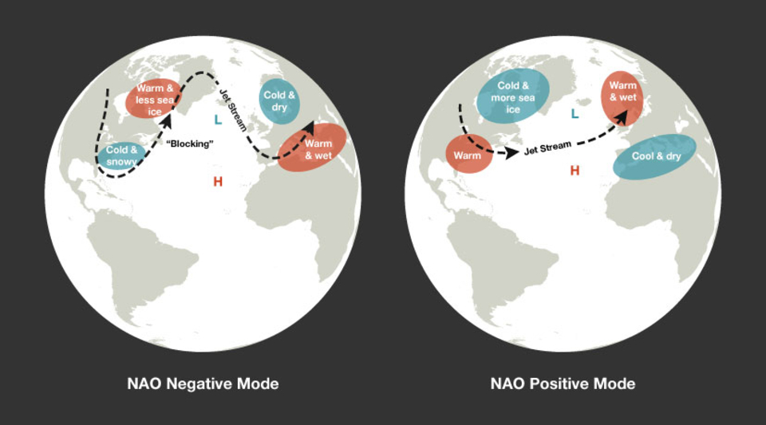
North Atlantic Oscillation
Polar Cordex Meeting at DMI Copenhagen 07.10. - 09.10.2019
Slide 1

Slide 4
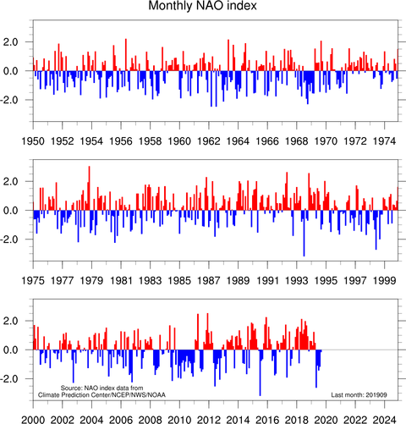
North Atlantic Oscillation
Polar Cordex Meeting at DMI Copenhagen 07.10. - 09.10.2019
Slide 1

Slide 5
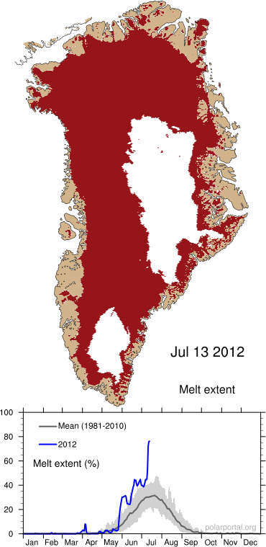
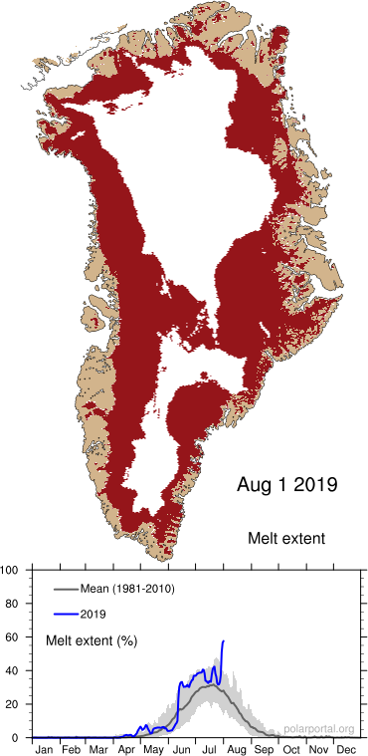
Persistent negative summer NAO associated with high ice sheet melt
2012
2019
Polar Cordex Meeting at DMI Copenhagen 07.10. - 09.10.2019
Slide 1

Slide 6

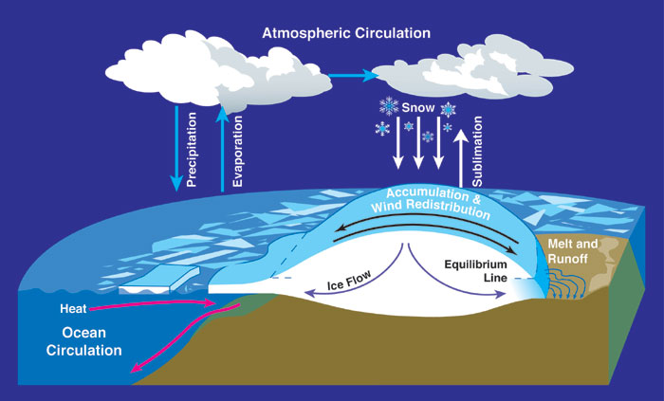
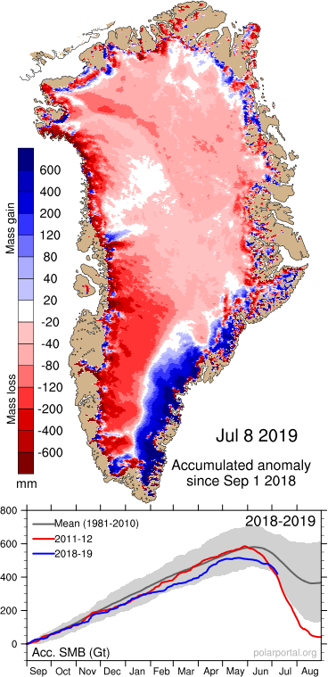
NAO Effects on Ice Sheet Mass Balance
Polar Cordex Meeting at DMI Copenhagen 07.10. - 09.10.2019
Slide 5

Slide 7
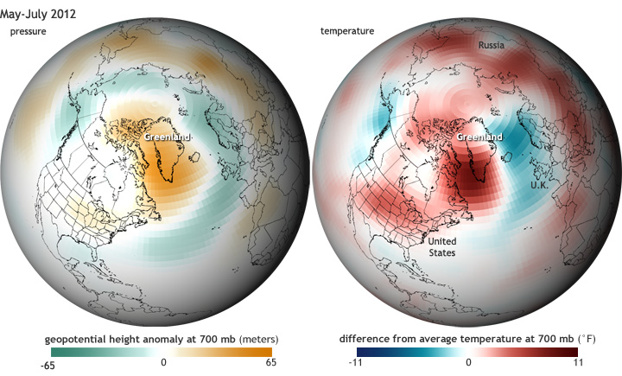
Greenland Blocking Index (GBI)
= geopotential height of 500 hPA area-averaged over Greenland
Associated with NAO, high GBI also enhances ice sheet melt
Polar Cordex Meeting at DMI Copenhagen 07.10. - 09.10.2019
Slide 5

Slide 8
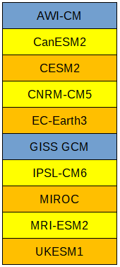
Used Models
blue: only historical simulation available
yellow/orange: historical simulation and future projections SSP245 and SSP585
Polar Cordex Meeting at DMI Copenhagen 07.10. - 09.10.2019
Slide 5

Slide 9
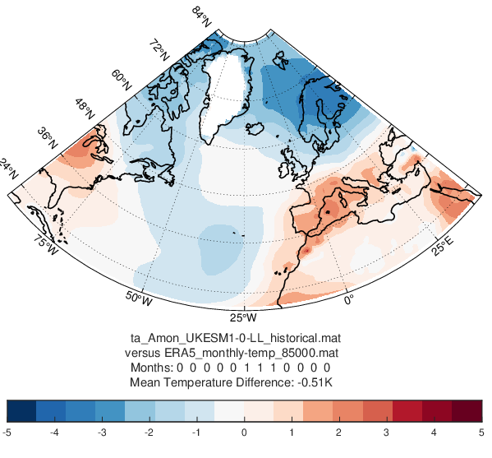
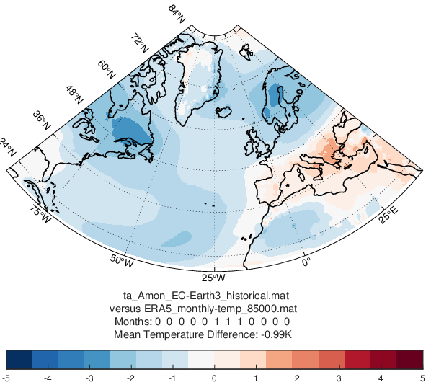
Temperature anomaly summer months
EC -Earth3
UKESM
Polar Cordex Meeting at DMI Copenhagen 07.10. - 09.10.2019
Slide 5

Slide 10
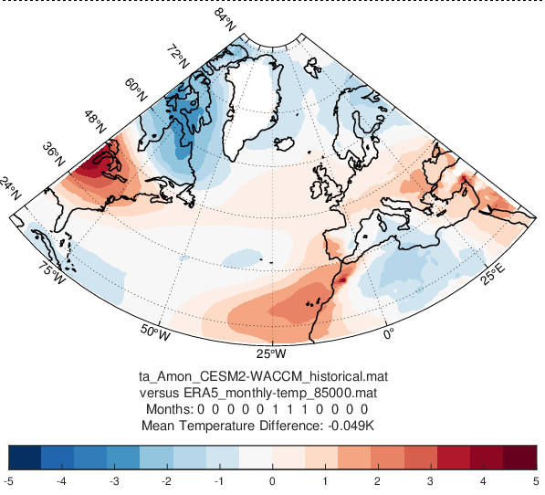
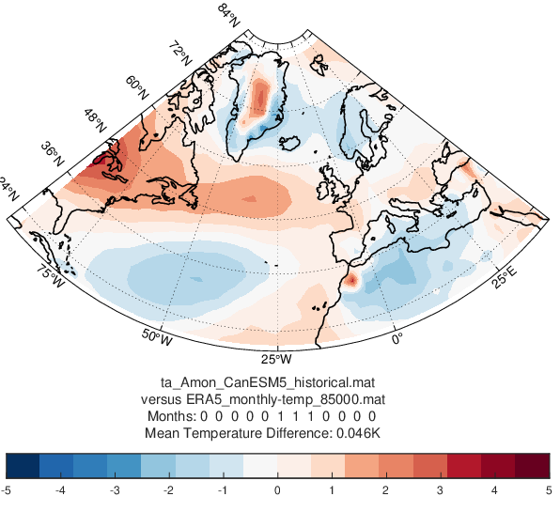
Temperature anomaly summer months
CESM2
CanESM5
Polar Cordex Meeting at DMI Copenhagen 07.10. - 09.10.2019
Slide 5

Slide 11
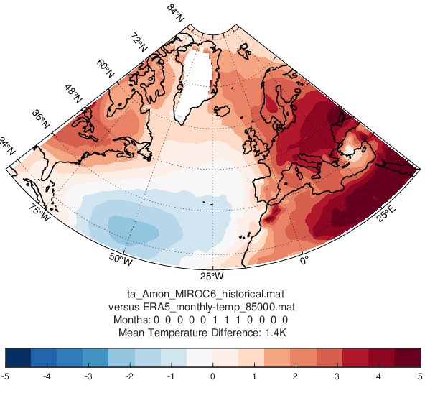
Temperature anomaly summer months
MIROC6
Polar Cordex Meeting at DMI Copenhagen 07.10. - 09.10.2019
Slide 5

Slide 12
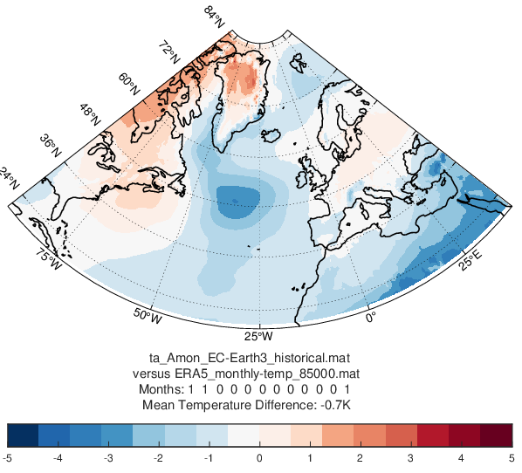
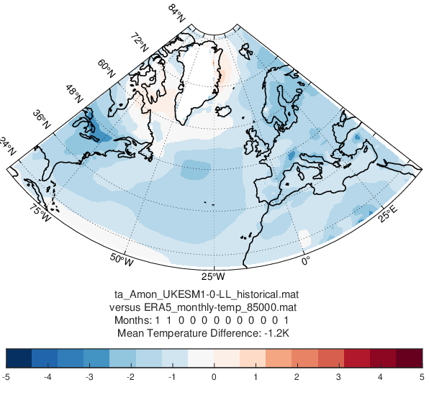
Temperature anomaly winter months
EC -Earth3
UKESM
Polar Cordex Meeting at DMI Copenhagen 07.10. - 09.10.2019
Slide 5

Slide 13
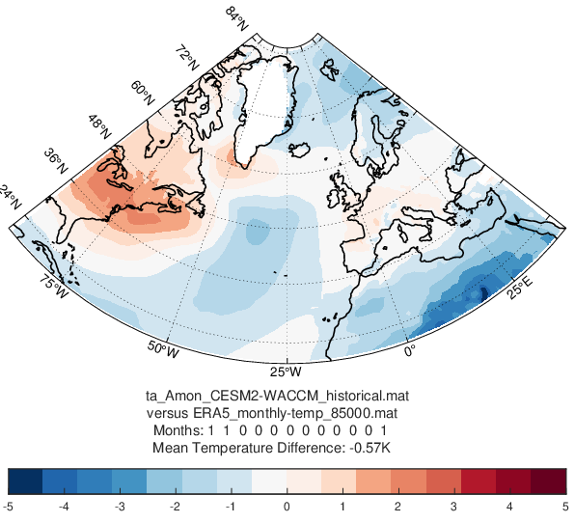
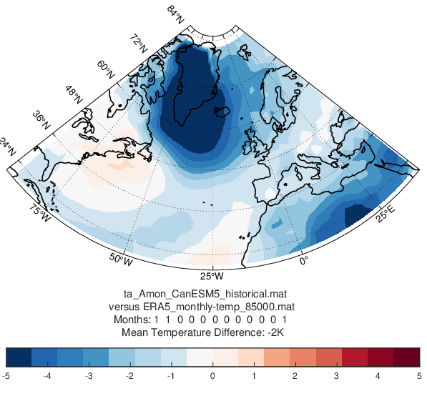
Temperature anomaly winter months
CESM2
CanESM5
Polar Cordex Meeting at DMI Copenhagen 07.10. - 09.10.2019
Slide 5

Slide 14
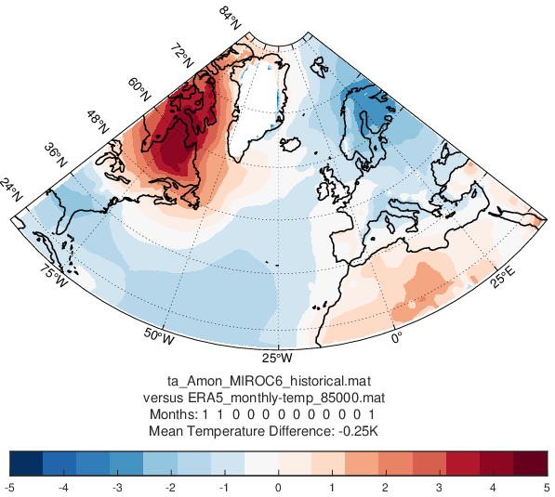
Temperature anomaly winter months
MIROC6
Polar Cordex Meeting at DMI Copenhagen 07.10. - 09.10.2019
Slide 5

Slide 15
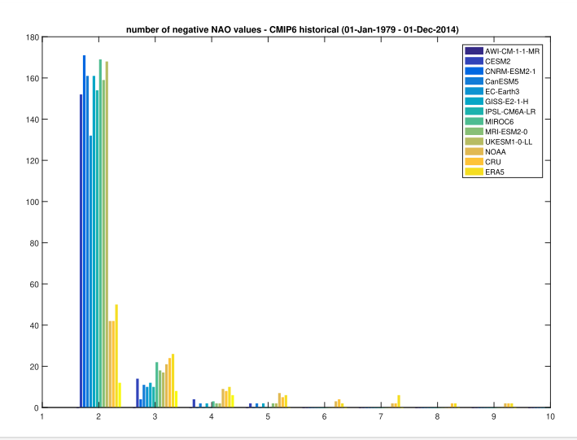
NAO Persistence
Polar Cordex Meeting at DMI Copenhagen 07.10. - 09.10.2019
Slide 5

Slide 16
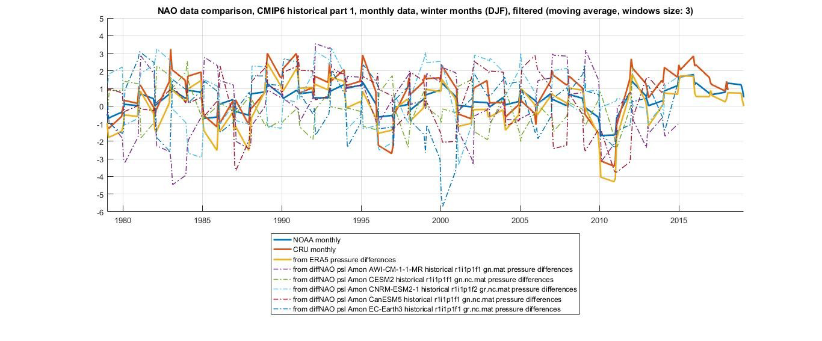
Modelled NAO Index
Polar Cordex Meeting at DMI Copenhagen 07.10. - 09.10.2019
Slide 5

Slide 17
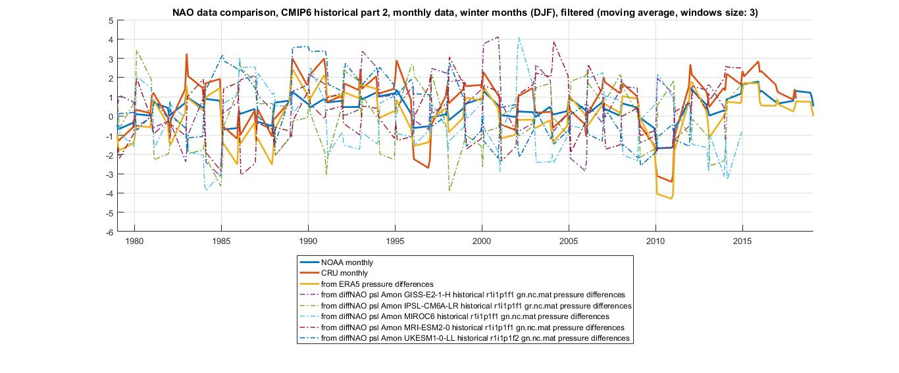
Modelled NAO Index
Polar Cordex Meeting at DMI Copenhagen 07.10. - 09.10.2019
Slide 5

Slide 18
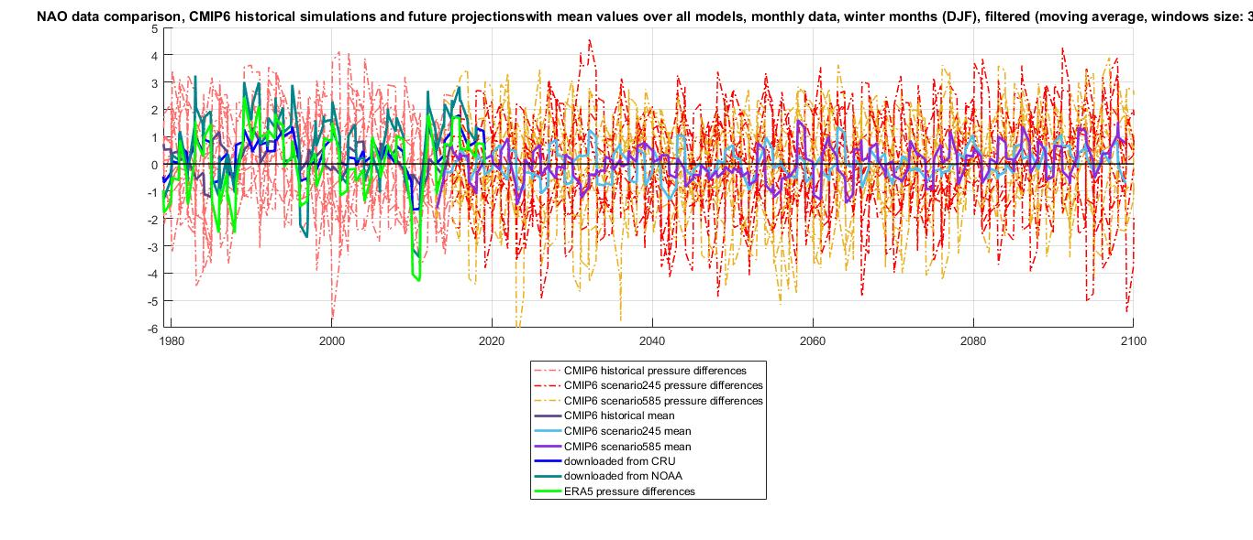
Modelled NAO Index
Polar Cordex Meeting at DMI Copenhagen 07.10. - 09.10.2019
Slide 5

Slide 19
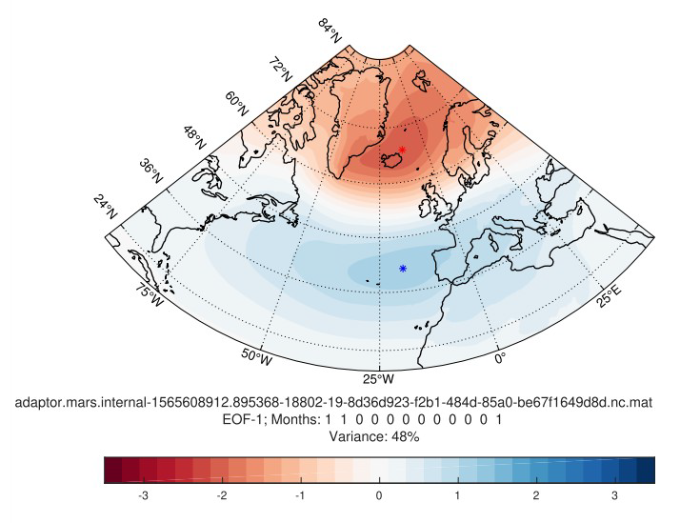
NAO - ERA5
NAO from Principal Component Analysis - Empirical Orthogonal Function
Polar Cordex Meeting at DMI Copenhagen 07.10. - 09.10.2019
Slide 5

Slide 20
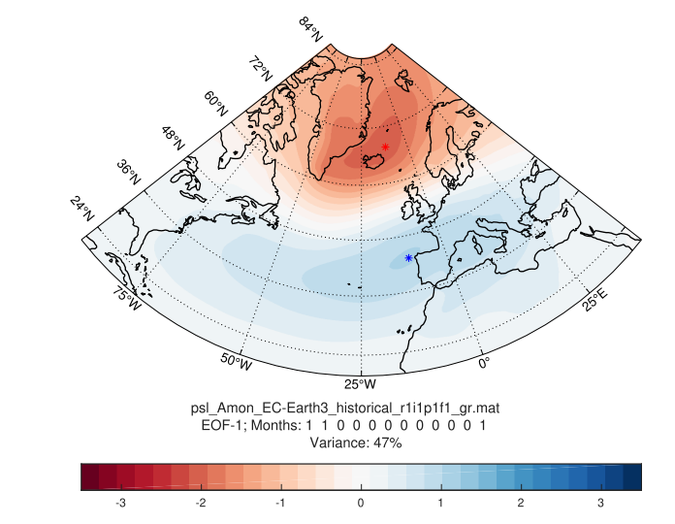

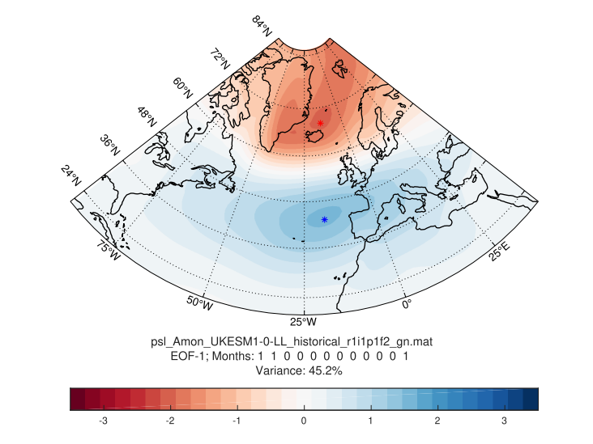
NAO - EC Earth and UKESM vs. ERA5
years 1979 - 2015
ERA5
EC-Earth
UKESM
Polar Cordex Meeting at DMI Copenhagen 07.10. - 09.10.2019
Slide 5

Slide 21
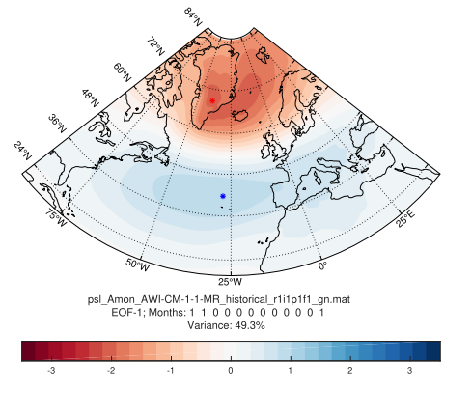
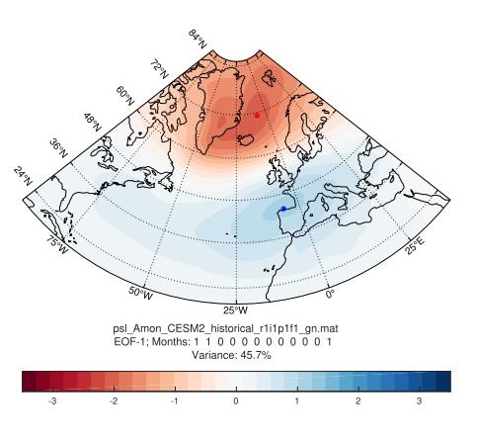
NAO - AWI-CM and CESM2 vs. ERA5
years 1979 - 2015
ERA5
AWI-CM
CESM2
Polar Cordex Meeting at DMI Copenhagen 07.10. - 09.10.2019
Slide 5

Slide 22
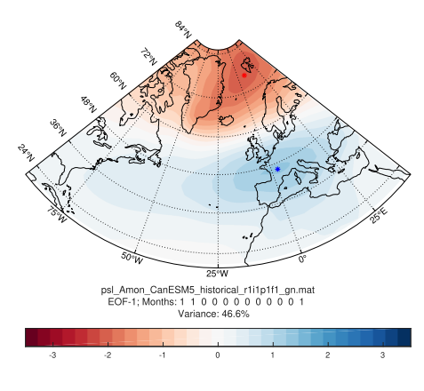
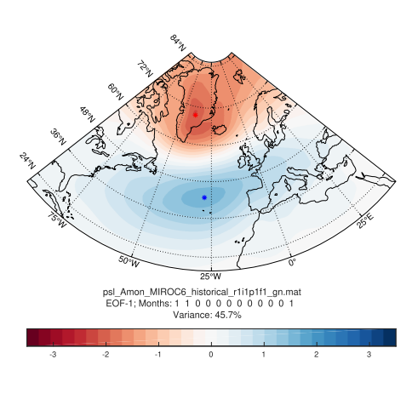
NAO - CanESM5 and MIROC6 vs. ERA5
years 1979 - 2015
ERA5
CanESM5
MIROC6
Polar Cordex Meeting at DMI Copenhagen 07.10. - 09.10.2019
Slide 5

Slide 23
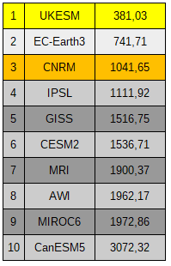
distance ranking
and the winner is...
(okay, that’s valid for this very special paramter...)
Polar Cordex Meeting at DMI Copenhagen 07.10. - 09.10.2019
Slide 5

Slide 24
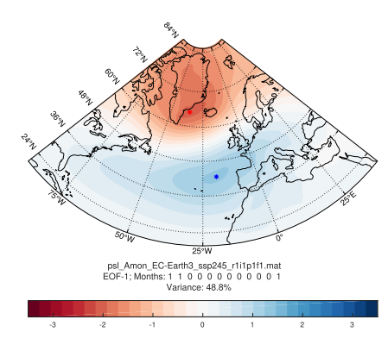
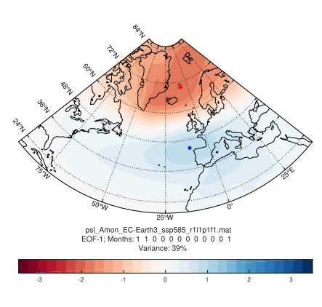
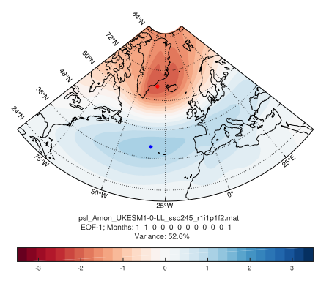
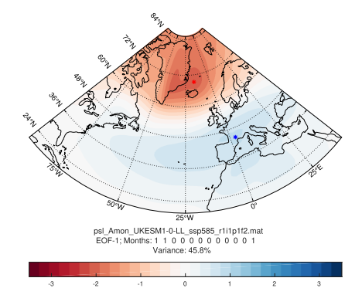
NAO - future projections
SSP 245
years 2080 - 2100
SSP 585
EC-Earth
ERA5
UKESM
Polar Cordex Meeting at DMI Copenhagen 07.10. - 09.10.2019
Slide 5

Slide 25
Take Away Messages
It’s important to look not only on absolute, but also on large scale circulation indices like NAO
The more extreme the scenarion, the more differences in the ensemble spread
Have a look on the geographical distribution --> EOF analysis

Slide 26
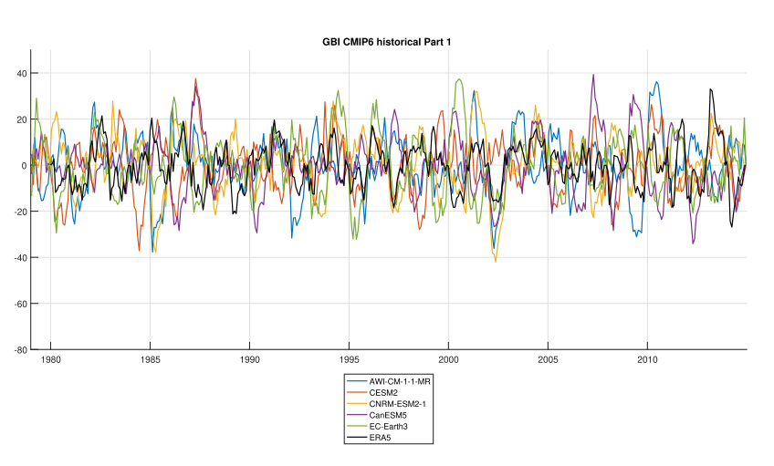
Outlook: GBI
Polar Cordex Meeting at DMI Copenhagen 07.10. - 09.10.2019
Slide 25

Slide 27
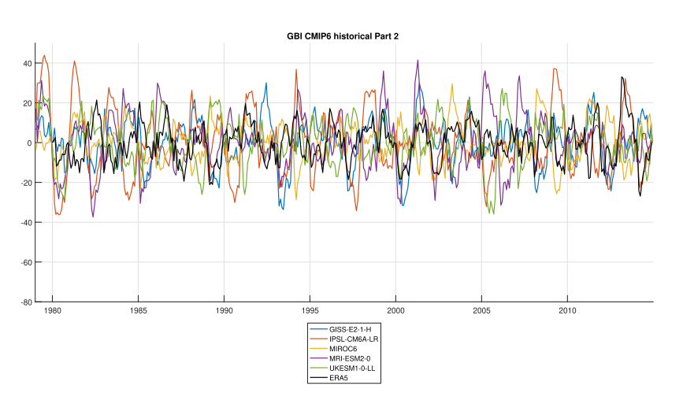
GBI
Polar Cordex Meeting at DMI Copenhagen 07.10. - 09.10.2019
Slide 25

Slide 28
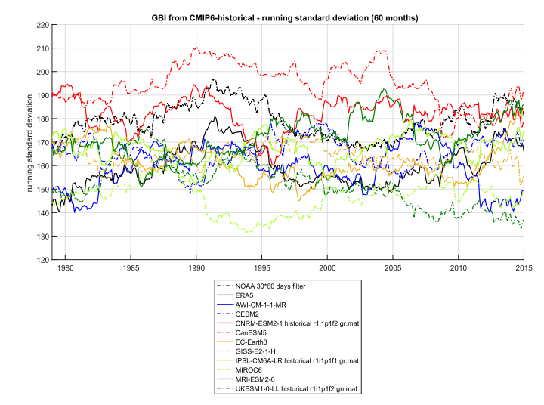
GBI - running standard deviation
Polar Cordex Meeting at DMI Copenhagen 07.10. - 09.10.2019
Slide 25

Slide 29
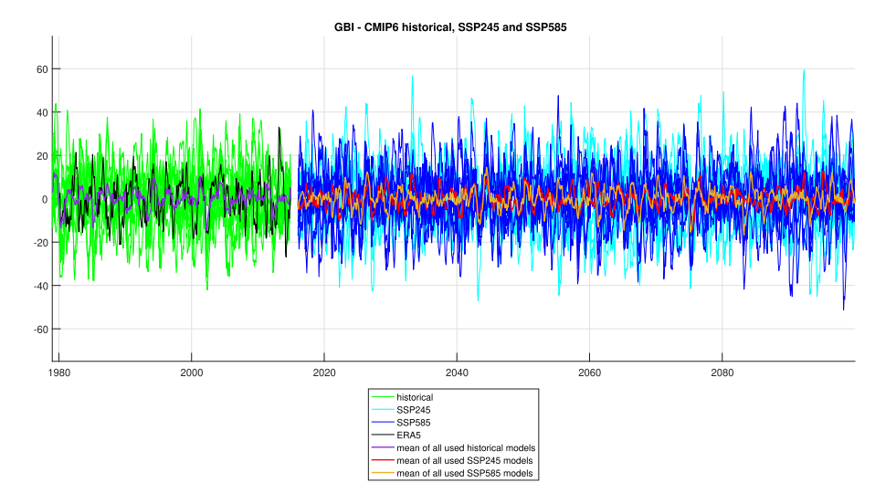
GBI - mean over all used models
Polar Cordex Meeting at DMI Copenhagen 07.10. - 09.10.2019
Slide 25

